Slide 1
Replications in Multi-Region Peer-to-peer Systems
Yuval Rochman
Computer Science
Tel-Aviv Univ.
Hanoch Levy
Computer Science
Tel-Aviv Univ.
Eli Brosh
Computer Science
Columbia Univ.

Slide 2
System and Problem
Players: End-User Terminals + a Central Video Server.
Function: Provide Video-on-Demand (VoD).
Objective: Central server is bottleneck ➔ need to reduce its load.
Solution: Use user terminals to store movies and upload to other terminals (Peer-to–Peer).
All controlled by central system (e.g. HOT).
Demand reduces
Video server
Router
User terminals

Slide 3
Single- and Multi-Region
Video server
Router
Single Region System.
User terminals
Multi Region System.
Video server
Router
Router
User terminals
User terminals
Problem: Where/How many to place movies ?

Slide 4
Related Work
Tewari & Kleinrock [2006] Proposed the Proportional Mean Replication.
Difference: diffrent goal function
Zhou, Fu & Chiu [ 2011]
Proposed the RLB Replication.
Difference: assume that the number of peers>> number of movies.

Slide 5
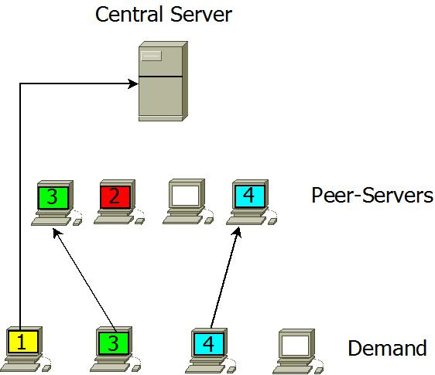
Model and Assumptions
Decompose terminals to server + client.
Each server can store one movie.
Server can upload one movie.
Collection of movies.
Servers content is managed by the central system.
Video server
Router
a
b
c
d
1
3
4
a
User terminals
b
c
d
a
b
c
d

Slide 6
Equivalent problem: The department store problem
k department stores with finite storage
Stochastic demand (full distribution)
Goal: place shirts in department stores.
Revenue:
Local > Remote > Factory
Clothing factory
Local storage
Stochastic demand
store 1
store 2

Slide 7
Challenge and principles
Challenge: Combinatorial problem based on multi-dimensional stochastic variables
Solution Keys: Convexity, Separability, Balance
Revenue:
Local > Remote > Factory
Clothing factory
Local storage
Stochastic demand
store 1
store 2

Slide 8
Toy problem: The single store (“Newsboy”)
Clothing factory
Local storage
Stochastic demand
clothing store

Slide 9
Formulation
shirt types
Store’s storage size: (constant)
Demand for shirt : , random variable.
Observed value of : .
Goal: Determine assignment of shirts to demand to maximize # granted requests.

Slide 10
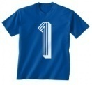
Example: Demand realization instance - Matching
Shirts
Observed Demand
Have a profit formula!!

Slide 11
Main Issues of Stochastic Problem
We have to maximize:
Random vars, must account for full distributions
Shirts
Random Demand

Slide 12
Key 1: Convexity
Partial expectation
Partial Expectations are convex!
Density (pdf): positive
Cumulative = monotonic
Partial expectation = monotonic convex

Slide 13
Solution
S.t
Equivalent to: find largest elements from where
Solution: Max-percentile algorithm in .

Slide 14
Max-percentile algorithm
Blue-candidates
Red-selected
Shirt type 1
Shirt type 2
Shirt type 3
Shirt type 4
Choose the 6 largest elements

Slide 15
Max-percentile algorithm
Blue-candidates
Red-selected
Shirt type 1
Shirt type 2
Shirt type 3
Shirt type 4
Choose the 6 largest elements

Slide 16
Max-percentile algorithm
Blue-candidates
Red-selected
Shirt type 1
Shirt type 2
Shirt type 3
Shirt type 4
Choose the 6 largest elements

Slide 17
Max-percentile algorithm (final)
Blue-candidates
Red-selected
Shirt type 1
Shirt type 2
Shirt type 3
Shirt type 4
Choose the 6 largest elements

Slide 18
Multi-store System
Revenue:
Local > Remote > Factory
Clothing factory
Local store
Stochastic demand
store 1
store 2

Slide 19
Key 2: Cost Separability
Cost transformation :
RELATIVE REVENUE
LOCAL , GLOBAL
➔ Cost separability
Clothing factory
store 2

Slide 20
Matching (multi-region)
Matching Problem:
Given deterministic demand, store shirts.
Match between demand and shirts.
Solution (simple) in linear time
Closed formula revenue.
?

Slide 21
The Multi-Regional problems
Symmetric bounded – this work, low complexity
Asymmetric unbounded - solved
Asymmetric bounded – most complicated, solved, higher complexity

Slide 22
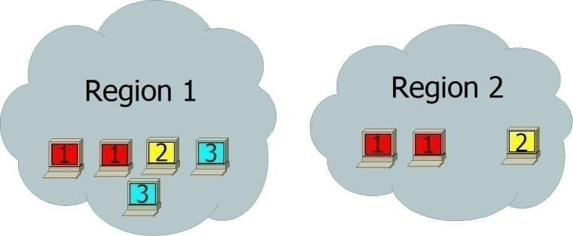
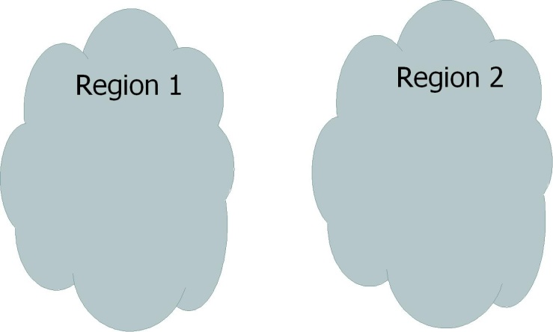
Equivalent & Balanced allocations
A quantity vector of an allocation:
Two allocations are called equivalent if they have the same quantity vector.
unbalanced
balanced
Equivalent allocations with Quantity vector of L=(4, 2, 2)

Slide 23
Main Result (Key 3 – balance)
Balance Principle: An optimal allocation must be balanced.
Potentially optimal
NOT optimal
➔ A greedy approach
Repeatedly add shirts one-by-one
Try add Y / R / B
For each take the balanced allocation
Select the best of the three
Balance principle + Convexity + Cost seperability ➔ optimality

Slide 24
Performance
Complexity: O(s(d+log s))
S = # shirts
d = size of density function
balanced

Slide 25
How good the results?
An alternative allocation: Proportional mean
Allocate movies (shirts) in proportion to the mean of the distribution

Slide 26
How bad can Proportional Mean be?
prob
Two movies.
S-number of servers
Proportional Mean will allocate S/(k+1) servers to red movies and k*S/(k+1) to blue movie.
Expected # granted requets= 2*S/(k+1)
Better allocation: n servers to red movie. Expected # granted requets =n.
1
1-1/k
1/k
0
n
nk²
requests

Slide 27
Questions

Slide 28
Thank you!

